Slide 1

YAY! - Celebrating Education

Slide 2


Python Course
(Basics)

Slide 3
Congratulations for reaching the end of the Python Basics Course!

Slide 4
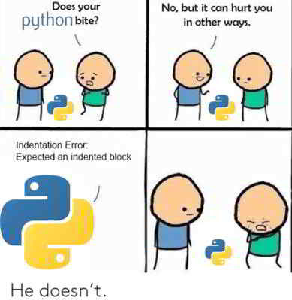

Slide 5
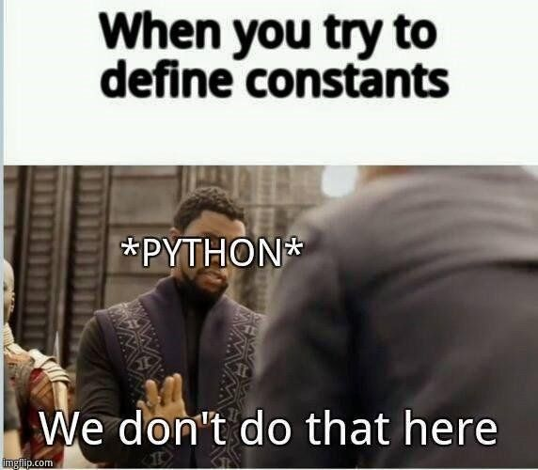

Slide 6
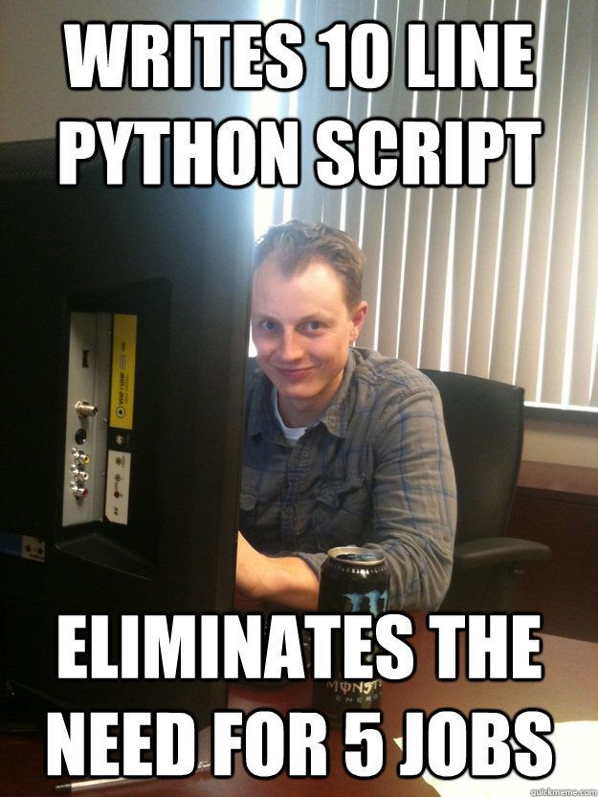

Slide 7
How to make a Project in Python

Slide 8
Agenda for Today
Introduction
What are we going to do?
What will we use?
What will we learn?
Project 1- Abstract
Project 2- Abstract

Slide 9
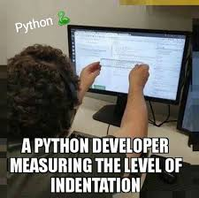
Introduction
So, the best and the most fun way to learn any programming language for me has always been by developing a fun project like a simple game or some project that I would use in my daily life.

Slide 10
What are we going to do?
We are going to build 2 projects in Python using the concepts learned in the duration of this course. We will also learn how to use GitHub and publish our project on GitHub.

Slide 11
What will we use?
We will build this game using Python 3, so make sure you have it installed on your laptop/computer and we are good to go.

Slide 12
What will we learn?
After building the projects, we will get a pretty clear idea about dictionaries in python, how to access dictionaries, how to iterate over dictionaries, for loop, if-else conditions and functions in python. We will also learn about libraries like Tkinter and Pyperclip.

Slide 13
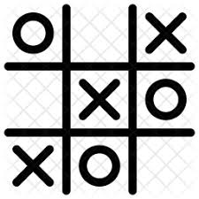
Project 1- Tic Tac Toe
We are going to build a two-player tic-tac-toe game, which we will be able to play against the computer. Initially, we’ll make an empty game board and then we’ll take inputs from the players and we’ll check for the winning condition and if the whole board gets filled, the results will be declared as “You won” or “You lost”.

Slide 14
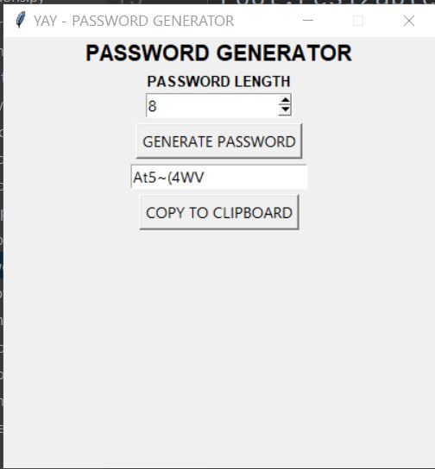
Project 2- Password Generator
We will build a Password Generator using libraries like Tkinter and Pyperclip in Python. In this, we will enter the length of the password that we want and on clicking the generate button it will auto-generate an alpha-numeric password for us. We will also add a copy to clipboard button.

Slide 15
Thank You!
See you in the next class!

